Slide 1
Cloud Orchestration
and Automation

Slide 2
$whoami
Threat Researcher at Cyware Labs
Previously worked as Devops and Security Engineer at Myglamm
Areas of Interest Include:
Security Automation
Designing Secure Solutions
Cloud Automation
Designing Pipelines

Slide 3
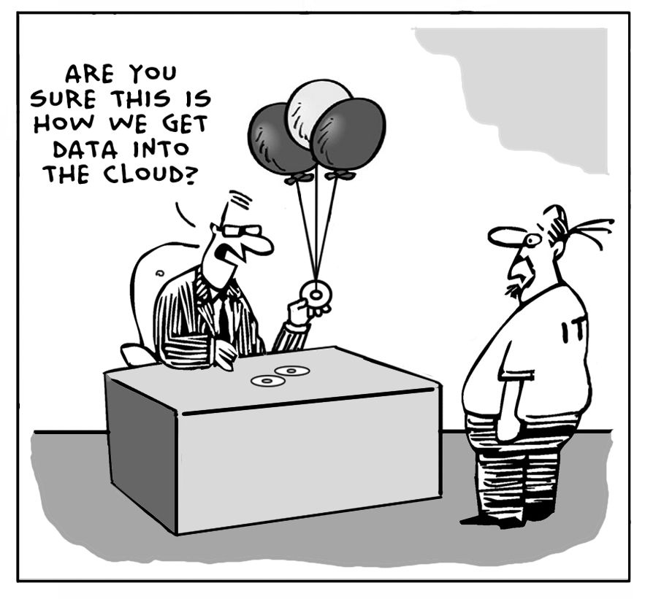
Notes:
How many of you know about Cloud Technologies?
How many of you have worked with Cloud Technologies?

Slide 4

200 people
80 developers
7 teams
15 Cloud Technologies

Slide 5
Cloud
ORCHESTRATION
and
AUTOMATION

Slide 6
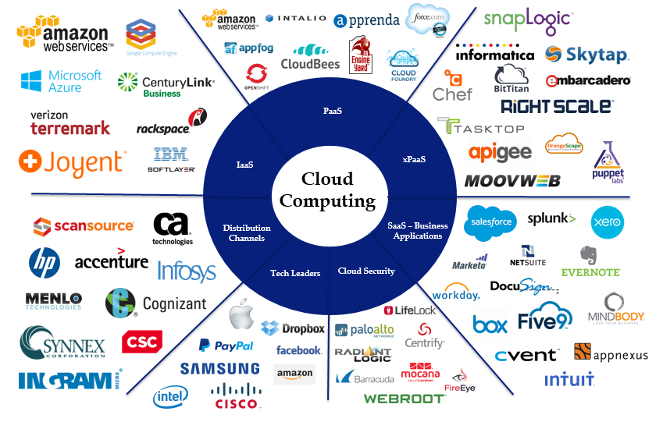
Notes:
Cloud Computing Landscape

Slide 7
Cloud Orchestration use cases:
Devops
Reduce development lifecycle
Scalability of containerized architecture
Reduce downtime
Notes:
Devops - developer operations in the cloud - Cloud access, cloud debugging

Slide 8
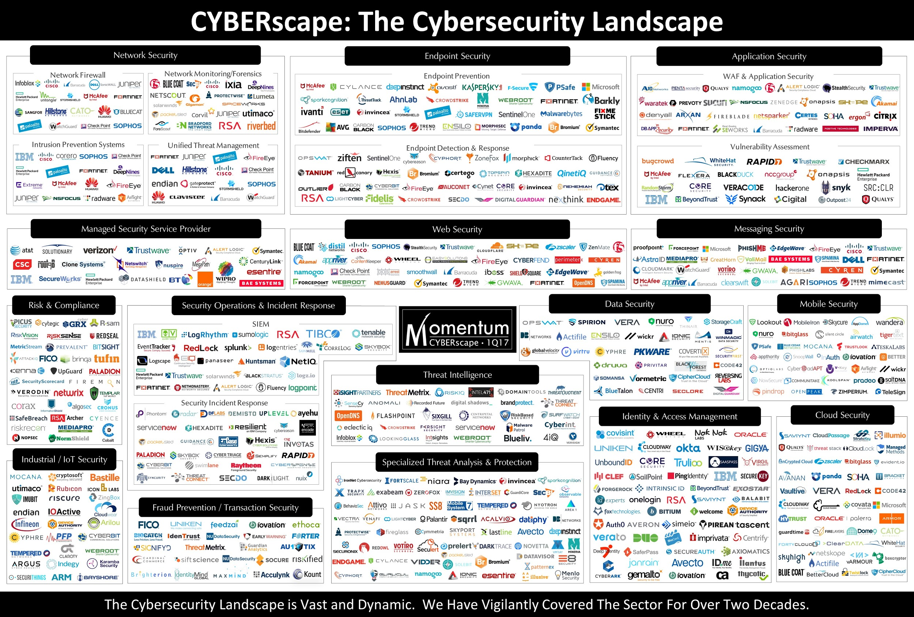

Slide 9
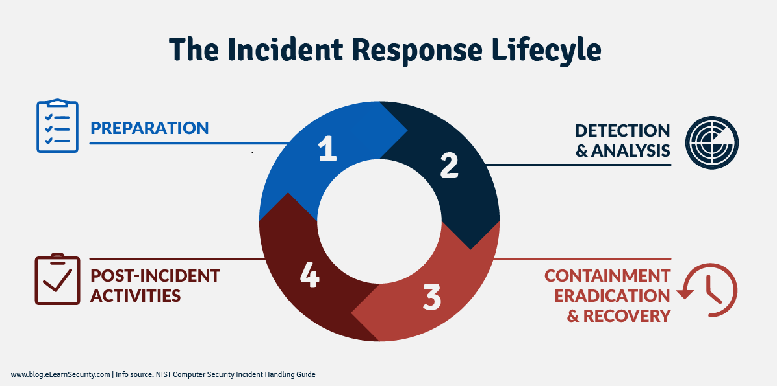

Slide 10
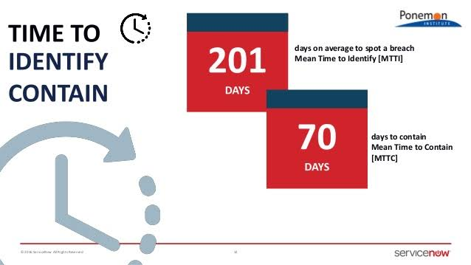

Slide 11
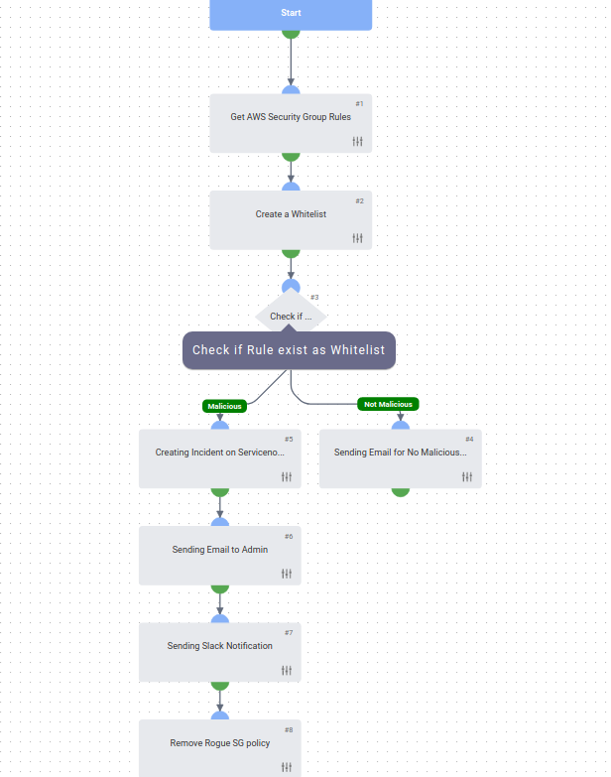
DEMO:
Cloud Orchestration
AWS Rogue Security Group policy check

Slide 12
Thank you!
Questions?

